Slide 1
“Araby”
Joyce and Modernism
“Two Gallants” “The Dead” and “Eveline”
Frankenstein
Grab Bag
10
10
10
10
10
20
20
20
20
20
30
30
30
30
30
40
40
40
40
40
50
50
50
50
50

Slide 2
Category 1 questions follow

Slide 3
Category 1
Why was the uncle late in “Araby”?
10

Slide 4
Category 1
The uncle was drunk and the boy knew the “signs” when the uncle finally arrived to their home.
10

Slide 5
Category 1
This term means “a sudden and striking realization” (and something we see occurring throughout Joyce’s short story collection, Dubliners.)
20

Slide 6
Category 1
An “epiphany” is a sudden and striking realization. An example would be when the boy realizes the “vanity” of his efforts to buy the girl a gift from “Araby”.
20

Slide 7
Category 1
What two colors are associated consistently with Mangan’s sister?
30

Slide 8
Category 1
Silver and brown. She wears a silver bracelet and is described as a brown figure.
30

Slide 9
Category 1
This symbolic object from Arthurian legend is imagined by the boy in “Araby” when he thinks of himself as a knight finding a gift for Mangan’s sister. It is known as the chalice used at “The Last Supper” by Jesus Christ and his disciples.
40

Slide 10
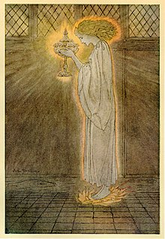
Category 1
The Holy Grail
40

Slide 11
Category 1
The boy in “Araby” looks over old books from the priest who used to live in the house. Name two of the books or two of the authors of those books. Last names are acceptable.
50

Slide 12
Category 1
The Abbot, by Sir Walter Scott is a 19th century historical novel which idealizes Mary, Queen of Scotts (a Catholic) who was executed by Queen Elizabeth in 1567
The Devout Communicant is a piece of Catholic devotional literature could have referred to any of several works, but certainly includes pious language and religious icons
The Memoirs of Vidocq was a popular account of a criminal named Vidocq (1775-1857) turned detective and translated from the French into English by and Irishman
50

Slide 13
Category 2 questions follow

Slide 14
Category 2
The Dead provides some direct critiques of British rule. Name one character who critiques Gabriel for writing for a newspaper that has Great Britain’s conservative politics.
10

Slide 15
Category 2
Molly Ivors
10

Slide 16
According to a Joyce critic, why is the following passage considered to be less historically accurate than other aspects of “Araby”:
“At the door of the stall a young lady was talking and laughing with two young gentlemen. I remarked their English accents and listened vaguely to their conversation.”
20

Slide 17
Category 2
Their “English” accents are not accurate:
In Joyce's 'Araby', the bazaar-girls and their customers whose conversation the narrator overhears are described as having 'English accents' ('Araby', 25.193-4). In reality, however, the volunteers at the Araby Bazaar were Irish. This is either another example of Joyce's creative adaptation of the real bazaar, or is possibly intended as an indication that these upper-middle-class Irish voices sounded English to the lower-middle-class narrator's inexperienced ear.
20

Slide 18
Category 2
Why did James Joyce have difficulty getting Dubliners published?
30

Slide 19
Category 2
Certain stories were considered too controversial for the publishers. “Two Gallants” was one of the examples of these “shocking” stories.
30

Slide 20
Category 2
Joyce focuses on the theme of people’s inability to leave or change throughout his stories in Dubliners. What is the name for his theme?
40

Slide 21
Category 2
Paralysis: Eveline cannot leave her home, Lenehan and Corley cannot change their law-breaking ways
40

Slide 22
Category 2
What musical instrument creates an intertextual relationship between “Araby” and “Two Gallants”?
50

Slide 23
Category 2
The harp.
“But my body was like a harp and her words and gestures were like fingers running upon the wires.”
“Araby”
“He plucked at the wires heedlessly, glancing quickly from time to time at the face of each new-comer and from time to time, wearily also, at the sky. His harp, too, heedless that her coverings had fallen about her knees, seemed weary alike of the eyes of strangers and of her master’s hands.” “Two Gallants”
50

Slide 24
Category 3 questions follow

Slide 25
Category 3
Where does Eveline want to go at the beginning of the story?
10

Slide 26
Category 3
Argentina (specifically, Buenos Aires)
10

Slide 27
Category 3
What point of view is “The Dead” written in?
20

Slide 28
Category 3
Third-person limited: we only get in the mind of certain people whereas with omniscient third-person we have a sense of all main characters
20

Slide 29
Category 3
What famous historical/religious figure is the women in blue and white associated with in “Two Gallants”?
“Her blue serge skirt was held at the waist by a belt of black leather. The great silver buckle of her belt seemed to depress the centre of her body, catching the light stuff of her white blouse like a clip.”
30

Slide 30
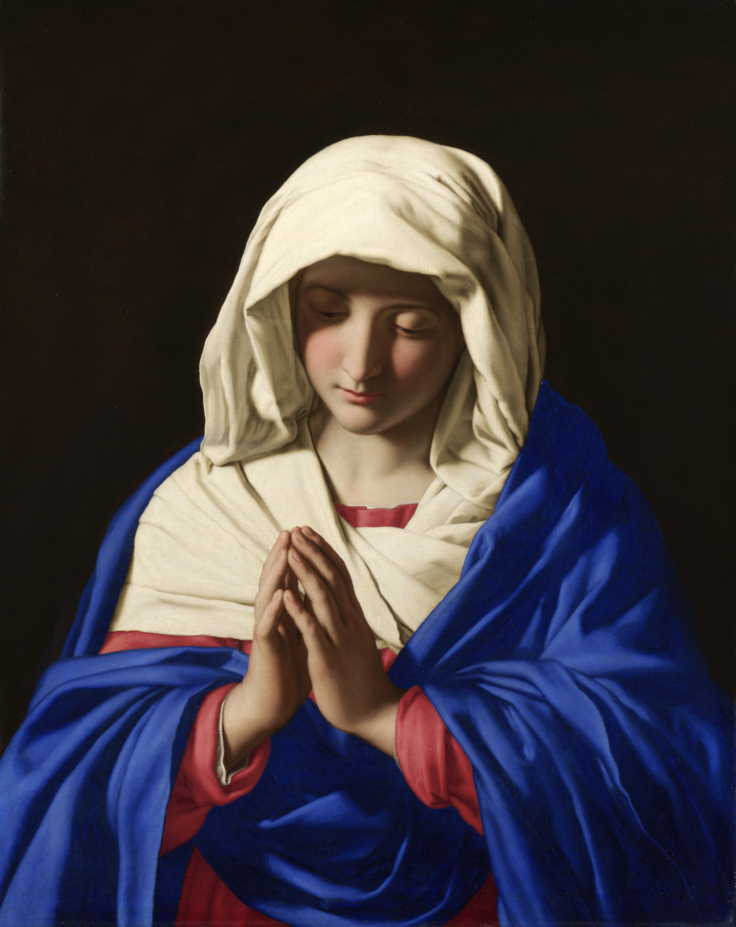
Category 3
The Virgin Mary (mother of
Jesus Christ/God in
Christian religion)
30

Slide 31
Category 3
What does it mean when Lenehan says “that takes the biscuit!” to Corley in “Two Gallants”?
40

Slide 32
Category 3
idiomatic, Britain) To be particularly bad, objectionable, or egregious.
Example: I've seen bad grammar, but this takes the biscuit.
American version: “that takes the cake”
40

Slide 33
Category 3
Eveline’s father says “He is in Melbourne now.” about the priest he used to know. What does this line imply about the priest according to your lecture notes on Joyce?
50

Slide 34
Category 3
Melbourne is located in Australia and was commonly associated with criminals at the time this story was published. The mention of it would create at best, a negative association with this priest and ,at worst, it would associate the Church with something criminal or against the law.
50

Slide 35
Category 4 questions follow

Slide 36
Category 4
What two characters from “Paradise Lost” does the Monster relate to the most?
10

Slide 37
Category 4
Adam and Satan (or Lucifer)
10

Slide 38
Category 4
What archetype is Victor Frankenstein?
20

Slide 39
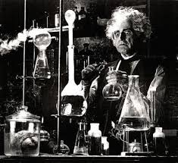
Category 4
The “mad scientist”
20

Slide 40
Category 4
During lecture, we’ve discussed different possible readings of Victor Frankenstein as an antihero. One criticism suggests he has a psychological disorder that makes it nearly impossible for him to have empathy for others. What is it?
30

Slide 41
Category 4
Narcissism. The term comes from the Greek myth of Narcissus who fell in love with his own image.
30

Slide 42
Category 4
There are many things that might have helped inspire Mary Shelley’s novel Frankenstein. Name three.
40

Slide 43
Category 4
Eruption of Mount Tambora and the “year without a summer” that followed
The bad weather, resulting in ghost stories at Lord Byron’s summer house in Switzerland
A nightmare
The experimentation on the frog with electrical currents
The loss of her own mother
Depression over the loss of her children
40

Slide 44
Category 4
The Monster/Creature learns to read by using three key texts. Name two of the authors or titles.
50

Slide 45
Category 4
Key Texts include: John Milton’s Paradise Lost, Plutarch’s Lives, and Goethe’s The Sorrows of Young Werther
50

Slide 46
Category 5 questions follow

Slide 47
Category 5
How much is a plate of peas?” he asked.
Name the character and the story.
10

Slide 48
Category 5
Lenehan in “Two Gallants”
He was hungry for, except some biscuits which he had asked two grudging curates to bring him, he had eaten nothing since breakfast-time. He sat down at an uncovered wooden table opposite two work-girls and a mechanic. A slatternly girl waited on him.
“How much is a plate of peas?” he asked.
“Three halfpence, sir,” said the girl.
“Bring me a plate of peas,” he said, “and a bottle of ginger beer.”
10

Slide 49
Category 5
Who was beheaded in 1649?
20

Slide 50
Category 5
King Charles I
(his son Charles II was restored to the throne in 1660 after ten years without a king)
20

Slide 51
Category 5
Both Victor and the Monster are self-taught men in terms of how they educate themselves. What is the term for a self-educated person/one who teaches oneself?
30

Slide 52
Category 5
Autodidact(auto=self in Greek/didact=teaching in Greek)
“Frankenstein is, among other things, a novel about two educations or, rather, miseducations, Victor’s and the Monster’s…Victor…is a sort of autodidact—willfully so, because he chooses isolation. In contrast, the Monster is perforce an autodidact…Victor’s education is upper-class, indulgent, liberal… “(469)
30

Slide 53
Category 5
Shelley connects Frankenstein to a Greek mythical character, Prometheus, in her subtitle. What did he do and how was he punished for his actions?
40

Slide 54
Category 5
Zeus had refused fire to humans and Prometheus snuck behind his back and gave it to them (he was a trickster god)
Zeus punished Prometheus in a terrible way: he was chained to a rock and an eagle would eat his liver during the day. It would grow back in the night and the eagle would come back and eat the liver again. Every day, forever until eventually Hercules saved Prometheus from this torture.
40

Slide 55
Category 5
Next week, we’ll be reading poetry from Mary Shelley’s husband, Percy Shelley; how did her young Romanticist husband die?
50

Slide 56
Category 5
Drowning
50

